Slide 1

Learning Intention: Today we are learning about Abraham, one of the key figures in Judaism.
Success Criteria:
By the end of the lesson I will be able to explain
. Who Abraham was and why he is significant to Jewish believers.
. The term “patriarch” and “covenant.”
. Key facts about the first covenant.

Slide 2
Judaism
Beliefs
• beliefs about God
• nature of human beings: yetzer tov; yetzer harah; free will; suffering
• beliefs about Covenant
• judgement; the Messiah; the Messianic Age; Olam Ha’ba
Practices
• living according to the Commandments
• Rosh Hashanah; Yom Kippur
• worship: Shabbat; synagogue

Slide 3

In order to understand the Jewish faith now, we have to explore the history that has defined this religion.
In the same way as you are shaped by your family and your history, so the Jewish faith is defined by its past.
No one is an island, we are all influenced by our roots. Judaism similarly is deeply influenced and impacted by the belief that they are a loved and chosen people and this comes from the story of a promise made to Abraham.
So in order to understand the Jewish story we need to study Abraham.

Slide 4
Judaism
Beliefs
• beliefs about God
• nature of human beings: yetzer tov; yetzer harah; free will; suffering
• beliefs about Covenant
• judgement; the Messiah; the Messianic Age; Olam Ha’ba
Practices
• living according to the Commandments
• Rosh Hashanah; Yom Kippur
• worship: Shabbat; synagogue

Slide 5
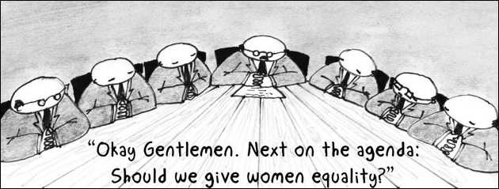
Abram/Abraham: The founding Father or Patriarch of Judaism
Patriarch ?
“The male head of a family or tribe.”

Slide 6
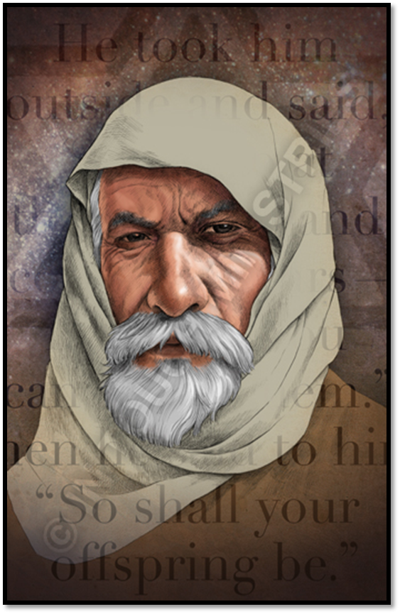
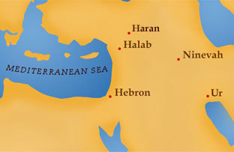
. Abraham lived over 4000 years ago.
. He is first mentioned in Genesis 11 when we discover he was a shepherd and came from Ur in Mesopotamia - modern day Iraq.

Slide 7
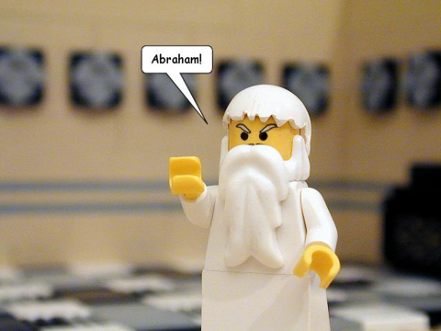
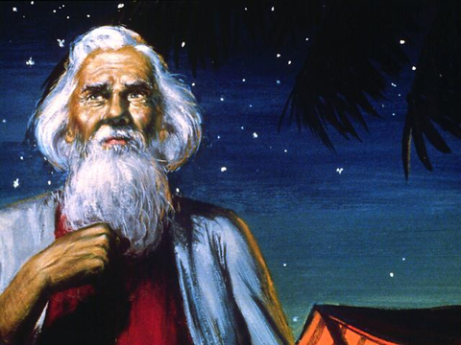
.Genesis 12 introduces the formal start of Judaism when God calls to Abram and he answers his call.
Therefore he is one of the founders of Judaism. His name changes from Abram to Abraham, meaning “father of multitudes.”
. He is seen as a role model and Jewish people try to be as obedient as he was to God.

Slide 8
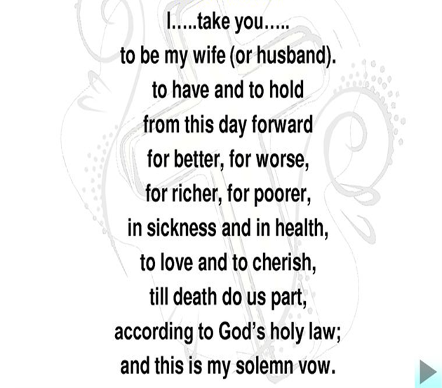
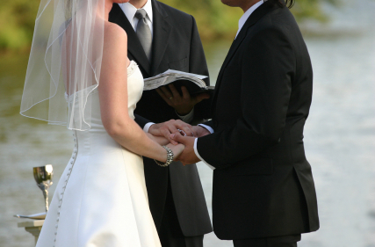
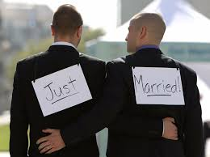
Abraham's life
Map showing the places associated with Abraham Map of the locations in Abraham's story
The story of Abraham and his descendents is found in the book of Genesis. We first meet him in Genesis chapter 11, although at this stage his name is Abram. There is very little biographical detail about him apart from the fact that he was a shepherd and came from Ur in Mesopotamia - modern day Iraq - after which he and his family moved, with his father Terah, to Haran.
This is a polytheistic age, an age when people believed in and worshipped many gods. Yet within this atmosphere, Abram answers the call of God and it is because of this that he accepts and realises the reality of there being only one true God.
In the Jewish tradition called Midrash (a Hebrew word which means 'interpretation' and relates to the way readings or biblical verses are understood), there are a number of stories about Abraham smashing his father's idols when he realises that there can be only one God of heaven and earth. It doesn't matter whether the stories are true or not. They acknowledge that Abraham was the first person to recognise and worship the one God. And so, monotheism was born.
At the beginning of Genesis chapter 12, God asked Abram to leave his home and country and he makes Abram three promises: the promise of a relationship with God, numerous descendents and land.
I will make you a great nation
And I will bless you;
I will make your name great,
And you will be a blessing
I will bless those who bless you,
And whoever curses you I will curse;
And all the peoples of the earth
Will be blessed through you
Genesis 12:1-3
The only problem is that both Abram and his wife, Sarai (later called Sarah) are old people and childless. They will have to leave their homeland and they don't even know who this God is! They seem to be an almost impossible set of promises for God to keep. But the amazing fact about Abram is that he does what he is asked. There are no signs or miracles; he has no scriptures or traditions on which to draw, so Abram has to place his trust in this nameless God. Consequently, Abram has gone down in history as a man of tremendous faith. As a result of his obedience, God changes his name to Abraham, meaning 'father of the people'.
The ultimate test of Abraham's obedience, however, comes in Genesis 22 when he is asked to sacrifice his son by Sarah - Isaac. God had promised that Abraham's descendents would come through Isaac, so the level of faith he displays is quite astonishing. Abraham trusts God and takes his son, as directed, up a mountain. At the very last minute, God intervenes and spares Isaac's life by providing another animal (a ram) for sacrifice. The test is complete and God once more reiterates his promises to Abraham of land, descendents and a personal relationship.
According to the Bible, Abraham is humanity's last chance to establish a relationship with God. At the beginning of the Bible in the creation narratives, Adam and Eve set in train a pattern of disobedience to God's commands which takes root. Even after the Great Flood, in which only Noah was saved, humanity once again comes perilously close to alienating themselves from their creator God. They build the tower of Babel (Genesis 11), a tower that seems like it will almost break through to the heavens and God again intervenes and scatters the people across the earth.
Many scholars believe these stories were written to explain to people why the world is like it is and why humans are like they are. What is our place in the world? Why do we die? They address questions of life and death, rather than being simply explanations about how the world was created.
At the end of Genesis 11, we are provided with a genealogy and Abraham becomes the new hope through which God will try and create a people to live by a certain set of values. The important thing to learn here is the uniqueness of the Covenant relationship between God and Abraham. For the first time, we see the beginning of a two-way relationship: God doing something for Abraham, and Abraham doing something for God. The blessings of God are passed on from one generation to another.
The story of Abraham is about obedience to the will of God - not blind obedience, because the Bible stories tell us that Abraham frequently challenged God and asked questions. But in the end, he trusted this God who had made such extraordinary promises and in so doing formed a very special and personal relationship with God which, believers will argue, has continued through to the present day.
The covenant
What is a covenant?
Question: Can you think of any covenants or agreements that are a part of our world ?
Lets think about the covenant of marriage.
What are the promises that two people make ?

Slide 9
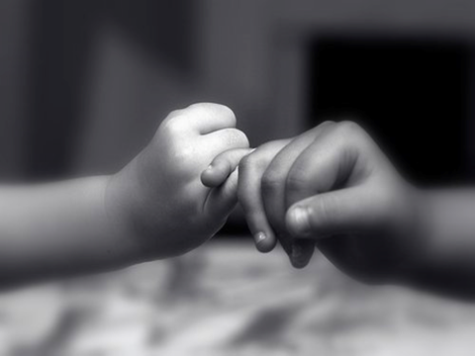
A covenant is an agreement between two groups of people or individuals.
The Abrahamic covenants are a sacred agreement between God and Abraham. God sets specific conditions, and he promises to bless Abraham and all those that follow him if his conditions are obeyed.
It is a promise and is like a legal document. From now on God and Abraham are bound together. They are the chosen people. There is a link between the past and the present.

Slide 10
Lets learn about the covenant between Abraham and God.
Covenant One:
Genesis 12:1- 7 and Genesis 13:14-18
What is this first covenant all about ?
Think about the idea of a covenant being a promise. What is God promising Abram? What is Abram promising God?
Covenant Two:
Genesis 15 1-18
What is this second covenant all about ?
Think about the idea of a covenant being a promise. What is God promising Abram? What is Abram promising God?
Covenant Three:
Genesis 17:1- 27
What is this first covenant all about ?
Think about the idea of a covenant being a promise. What is God promising Abram? What is Abram promising God?

Slide 11
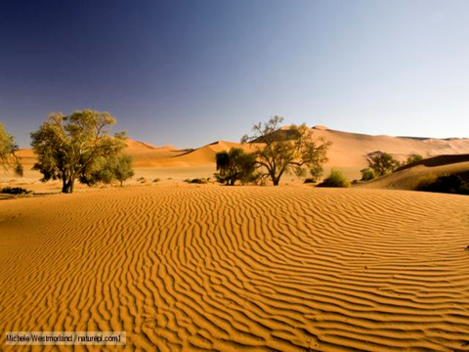
Covenant One: Land
Genesis 12 (Torah)
The Call of Abram
¹ The LORD had said to Abram, "Leave your country, your people and your father's household and go to the land I will show you. (Promised land)
² "I will make you into a great nation
and I will bless you;
I will make your name great,
and you will be a blessing.
³ I will bless those who bless you,
and whoever curses you I will curse;
and all peoples on earth
will be blessed through you."

Slide 12
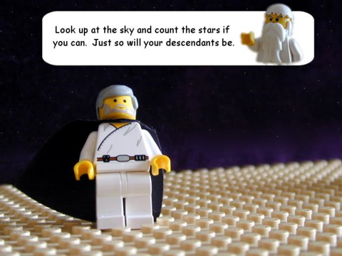
People
Genesis 15:5-14 (Torah)
⁵ He took him outside and said, "Look up at the heavens and count the stars—if indeed you can count them." Then he said to him, "So shall your offspring be."
⁶ Abram believed the LORD, and he credited it to him as righteousness.
⁷ He also said to him, "I am the LORD, who brought you out of Ur of the Chaldeans to give you this land to take possession of it."
⁸ But Abram said, "O Sovereign LORD, how can I know that I will gain possession of it?"
⁹ So the LORD said to him, "Bring me a heifer, a goat and a ram, each three years old, along with a dove and a young pigeon."
¹⁰ Abram brought all these to him, cut them in two and arranged the halves opposite each other; the birds, however, he did not cut in half. ¹¹ Then birds of prey came down on the carcasses, but Abram drove them away.
¹² As the sun was setting, Abram fell into a deep sleep, and a thick and dreadful darkness came over him. ¹³ Then the LORD said to him, "Know for certain that your descendants will be strangers in a country not their own, and they will be enslaved and mistreated four hundred years. ¹⁴ But I will punish the nation they serve as slaves, and afterward they will come out with great possessions.

Slide 13
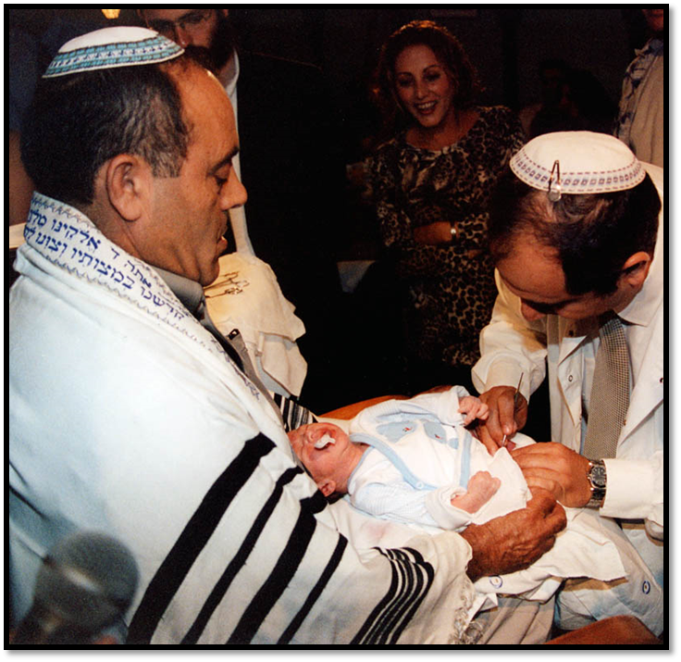
A people set apart, circumcision. A sign of the covenant.
Genesis 17 –The Torah
The Covenant of Circumcision
¹ When Abram was ninety-nine years old, the LORD appeared to him and said, "I am God Almighty; walk before me and be blameless. ² I will confirm my covenant between me and you and will greatly increase your numbers." ³ Abram fell facedown, and God said to him, ⁴ "As for me, this is my covenant with you: You will be the father of many nations. ⁵ No longer will you be called Abram; your name will be Abraham, for I have made you a father of many nations. ⁶ I will make you very fruitful; I will make nations of you, and kings will come from you. ⁷ I will establish my covenant as an everlasting covenant between me and you and your descendants after you for the generations to come, to be your God and the God of your descendants after you. ⁸ The whole land of Canaan, where you are now an alien, I will give as an everlasting possession to you and your descendants after you; and I will be their God."
⁹ Then God said to Abraham, "As for you, you must keep my covenant, you and your descendants after you for the generations to come. ¹⁰ This is my covenant with you and your descendants after you, the covenant you are to keep: Every male among you shall be circumcised. ¹¹ You are to undergo circumcision, and it will be the sign of the covenant between me and you. ¹² For the generations to come every male among you who is eight days old must be circumcised, including those born in your household or bought with money from a foreigner—those who are not your offspring. ¹³ Whether born in your household or bought with your money, they must be circumcised. My covenant in your flesh is to be an everlasting covenant. ¹⁴ Any uncircumcised male, who has not been circumcised in the flesh, will be cut off from his people; he has broken my covenant."
Circumcision is a medical procedure where the foreskin is cut away from the penis.

Slide 14
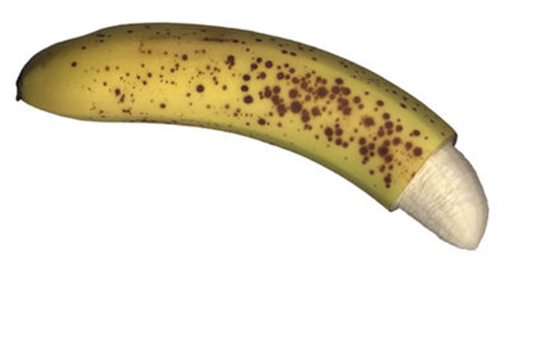
Circumcision

Slide 15
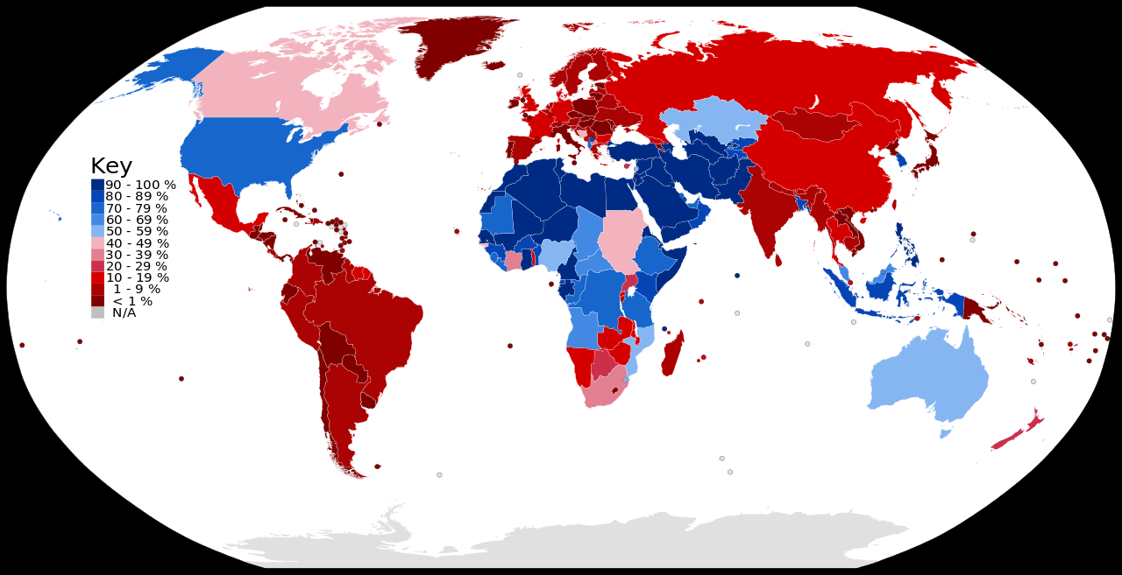

Slide 16
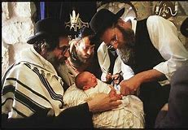
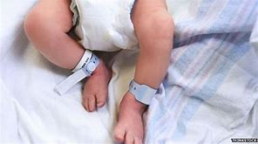
Circumcision is practiced by many people in the world but it is only for the Jewish people that it is a sign of their acceptance of their relationship with God.
This is a special event in a Jewish family which is called Brit Milah (prounounced breet meelah)
It is a an external symbol of the covenant.
It is the oldest Jewish ritual and one that has remained unchanged to the present day.

Slide 17
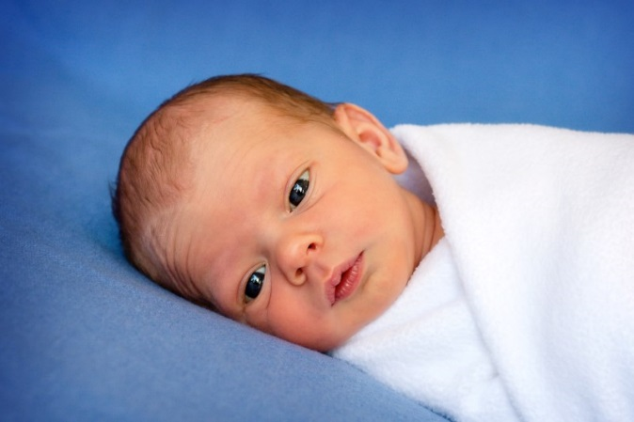
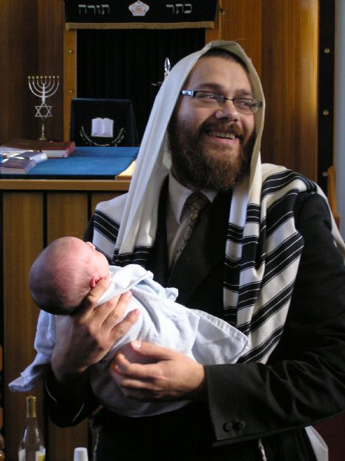
The ceremony takes place either at home or in the hospital, on the 8th day after the baby is born.
It is performed by a specially trained person called a Mohel.
It is a sign that the infant has joined the covenant
‘You shall be circumcised in the flesh of your foreskins, and it shall be a sign of the covenant between me and you.’ Genesis 17

Slide 18
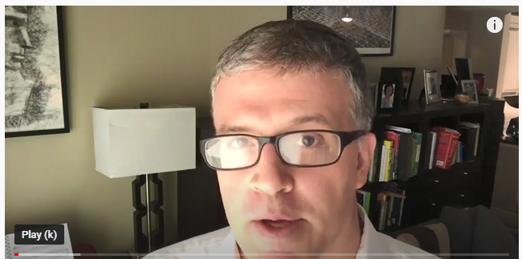
Lets find out more.
https://www.youtube.com/watch?v=VC6P2FrZf2g

Slide 19
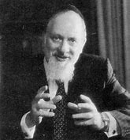
The covenant between God and Abraham show the distinctiveness that
God placed on Jews.
Before the Torah was written the covenant was important because it was their connection with God
All Jews are children of ‘Abraham’ and are bound by these covenants.
This places responsibilities on Jews to live by the rules of the Torah.
I believe that every individual is chosen or destined for some distinct purpose. Maybe the Greeks were chosen for their unique contributions to art and philosophy, the Romans for their law and government. The Jews were chosen by G-d to be the pioneers of religion and morality, and that is our national purpose.
Rabbi Lord Immanuel Jakobovits

Slide 20
Time to learn a quote: Choose one and learn it !
“I will take you as my own people and I will be your God.” Exodus 7:6
“I will make you a great nation and I will bless you.” Genesis 12:2

